Slide 1

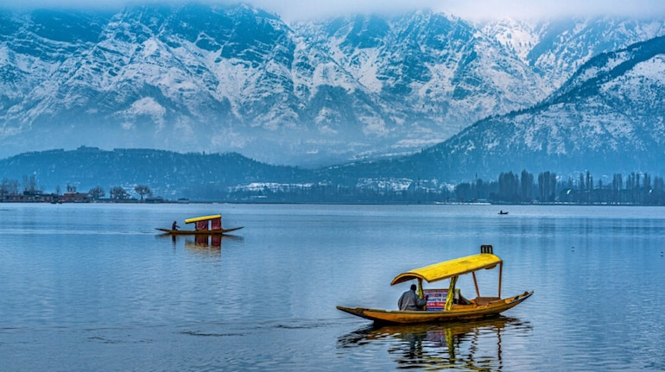
JAMMU & KASHMIR
Known for its breathtaking landscapes, Jammu and Kashmir is famous for snow-capped mountains, serene lakes like Dal Lake, and lush valleys. Rich in culture, it boasts historical sites like the Vaishno Devi temple and Mughal gardens, alongside a vibrant Kashmiri cuisine and handicrafts.
JAMMU & KASHMIR

Slide 2
JAMMU & KASHMIR
JAMMU & KASHMIR
Known for its breathtaking landscapes, Jammu and Kashmir is famous for snow-capped mountains, serene lakes like Dal Lake, and lush valleys. Rich in culture, it boasts historical sites like the Vaishno Devi temple and Mughal gardens, alongside a vibrant Kashmiri cuisine and handicrafts.

Slide 3

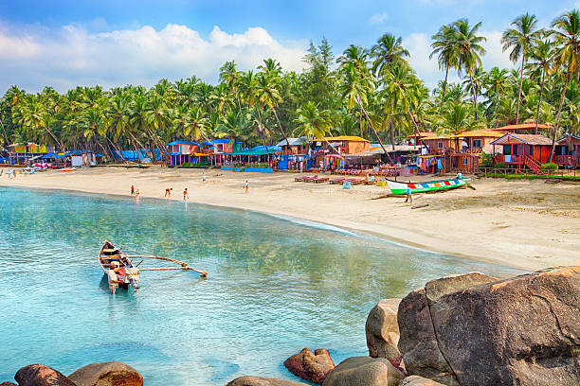
GOA
GOA
Known for its golden beaches, vibrant nightlife, and Portuguese influence, Goa is a popular tourist destination. It offers a blend of rich history, colonial architecture, and a laid-back atmosphere. The state is also famous for its spice plantations, seafood, and lively festivals like Carnival.

Slide 4
GOA
GOA
Known for its golden beaches, vibrant nightlife, and Portuguese influence, Goa is a popular tourist destination. It offers a blend of rich history, colonial architecture, and a laid-back atmosphere. The state is also famous for its spice plantations, seafood, and lively festivals like Carnival.

Slide 5
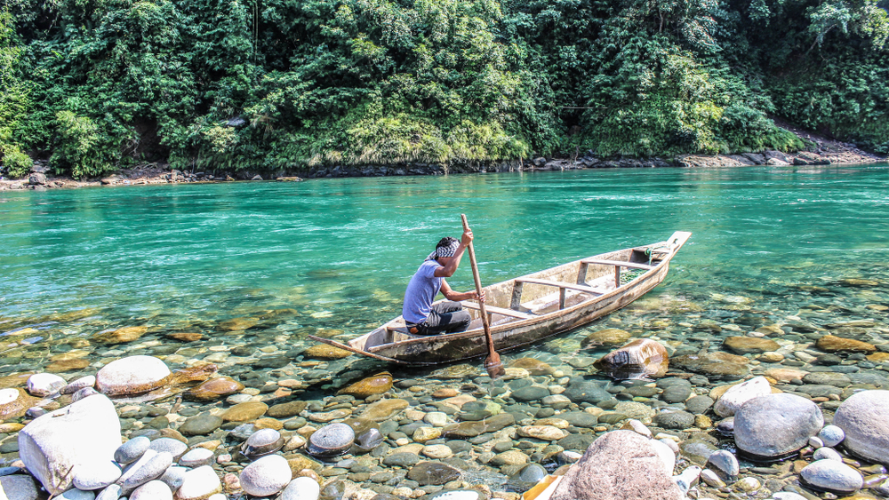

MEGHALAYA
MEGHALAYA
Known as the "Abode of Clouds," Meghalaya is a beautiful state in Northeast India, famous for its lush green landscapes, rolling hills, and stunning waterfalls like Nohkalikai. Rich in culture, it is home to unique living root bridges and vibrant tribal traditions, offering a serene, natural retreat.

Slide 6
MEGHALAYA
MEGHALAYA
Known as the "Abode of Clouds," Meghalaya is a beautiful state in Northeast India, famous for its lush green landscapes, rolling hills, and stunning waterfalls like Nohkalikai. Rich in culture, it is home to unique living root bridges and vibrant tribal traditions, offering a serene, natural retreat.

